Slide 1
VEHICLE MANAGEMENT SYSTEM
Team leader : A.Kalaivani
Team member1: R. Boomika
Team member2: M.Birundha devi
Team member3: M.Nagalakshmi
Team member4 :C.Priyadharshini

Slide 2
1.Introduction
Overview
Vehicle Management is an application where a customer Details are stored in order to choose cars, bikes and commercial vehicles for travel with in the city.
The data which is stored here is further used to remind them if any offers are provided during the seasons any updates regarding vehicles are sent to them in the form of messages and mails.
Purpose
Vehicle Management System created by SCAND are design to help our clients is keep track of the vehicle in real time, plan, execute and optimize. There transportation process through GPS and data collection.
Keep track of malfunctions.
Leverage driver retention.

Slide 3
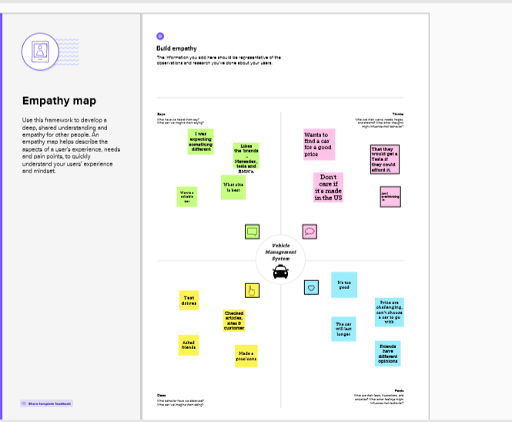
2.Problem Definition & Design Thinking
Empathy Map

Slide 4
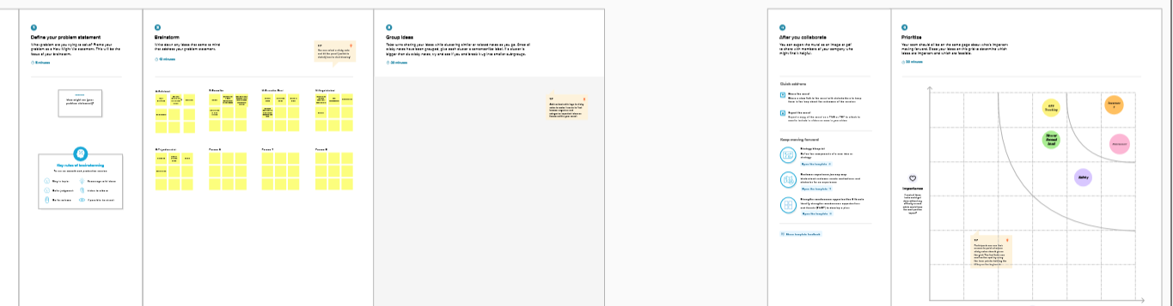
Ideation & Brainstorming Map

Slide 5
3.Result
Data Model
Object name | Fields in the Object
Vehicle
Driver
Field label | Data type
Customer name | Text
Customer mobile No | Number
Field label | Data type
Driver name | Text
Vehicle | Lookup(vehicle)

Slide 6
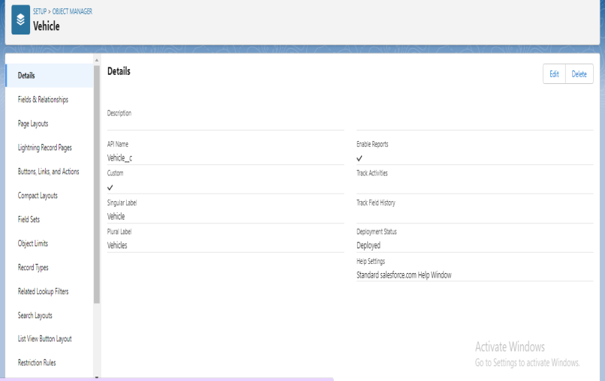
Activity & Screenshot
OBJECT
That permit you to store data that is specific to an organization.
Object that are provided by salseforce.com such as users, contract, report, dashboard, etc.

Slide 7
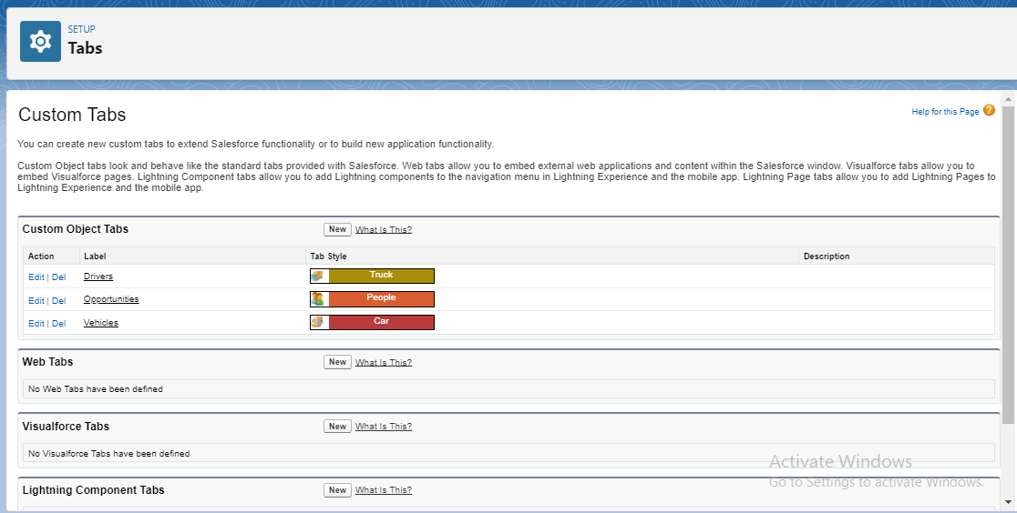
TAB

Slide 8
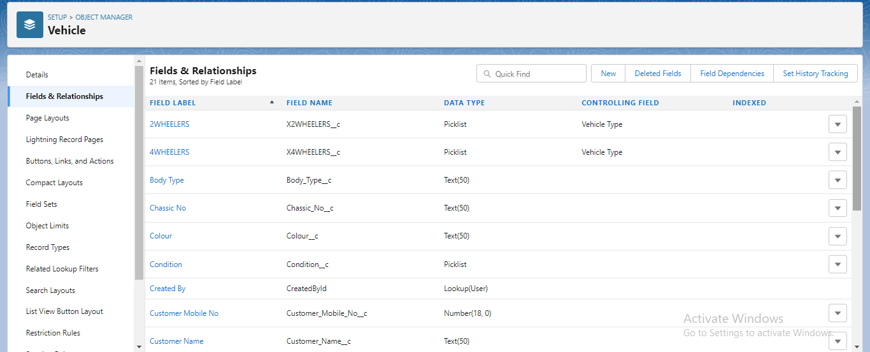
FIELD AND RELATIONSHIP
An object relationship in salesforce is a two way association between two objects.

Slide 9
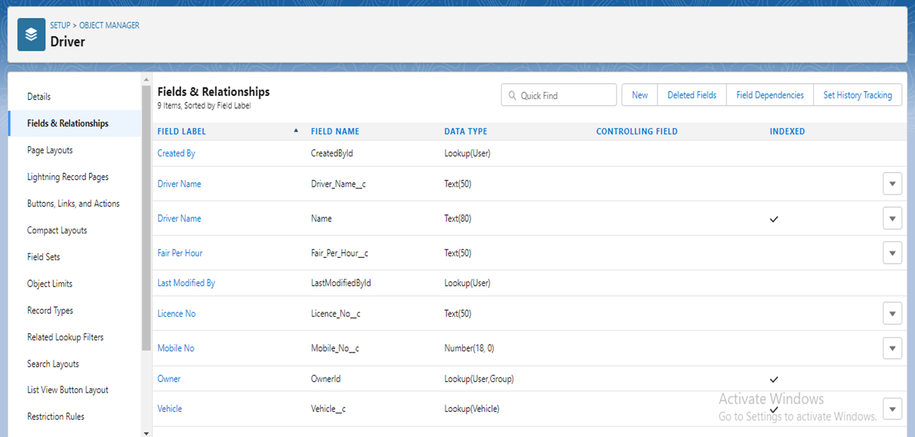
Relationships are created by creating custom relationship fields on an objects.

Slide 10
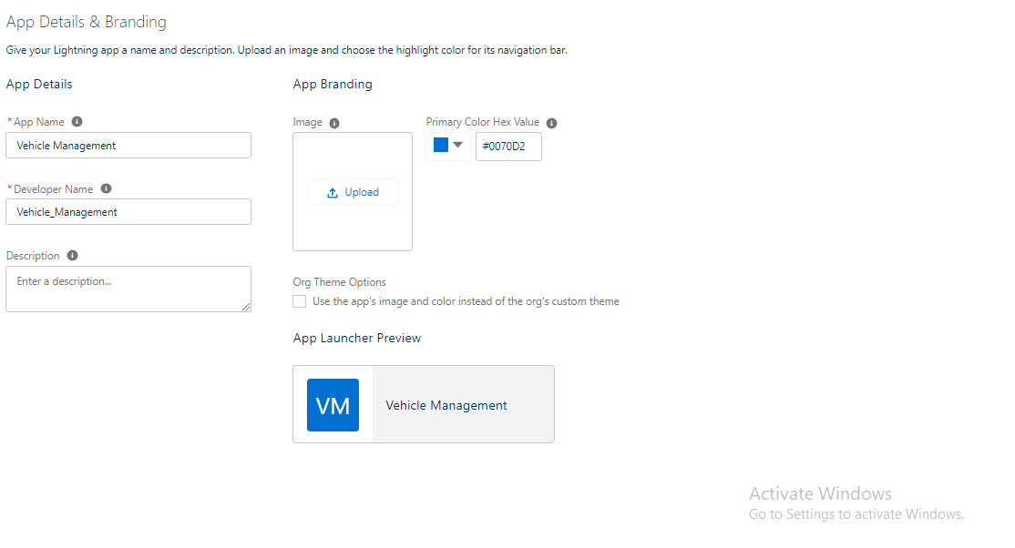
LIGHTNING APP
Apps in salseforce are a group of tabs that help the application function by working together as a unit.

Slide 11
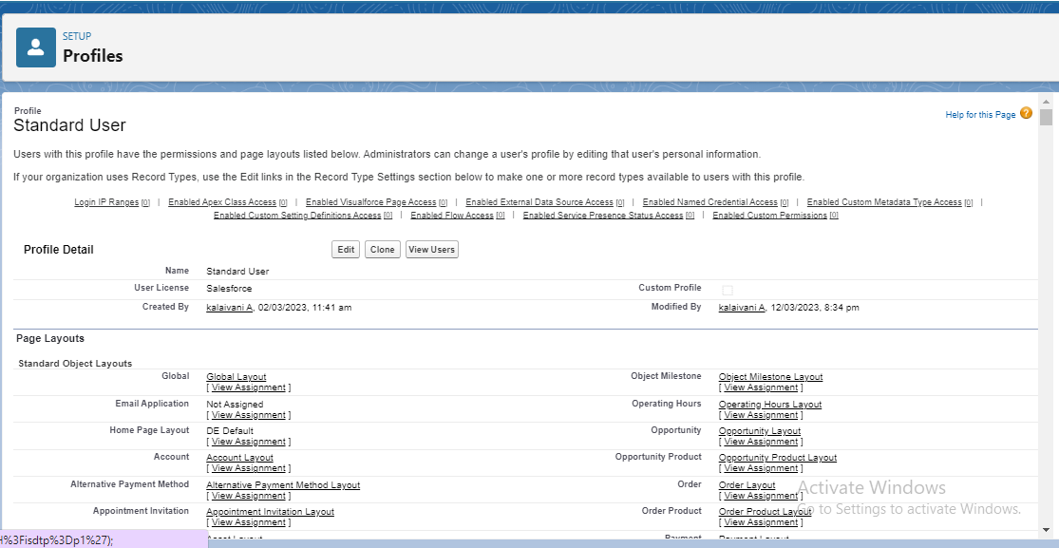
PROFILES
A profile is a group of settings and permissions that define what a user can do in slaseforce.

Slide 12
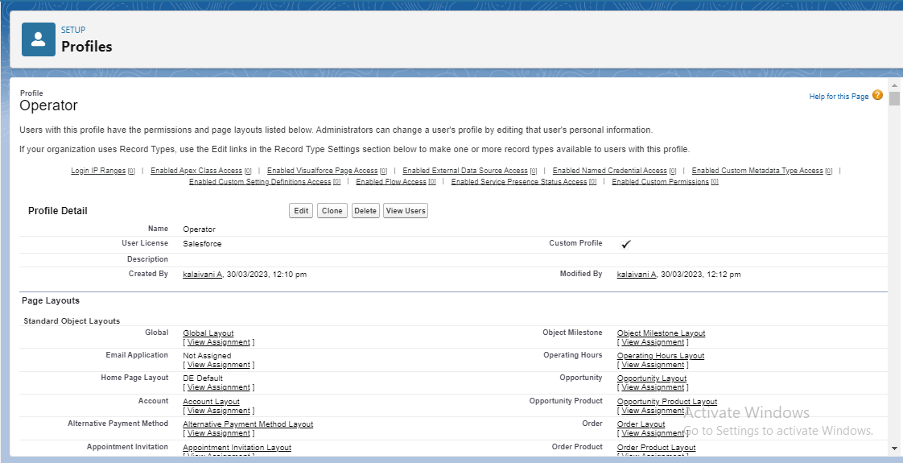
A profile controls object permissions, field permission, user permission, tab settings, app settings, record types.

Slide 13
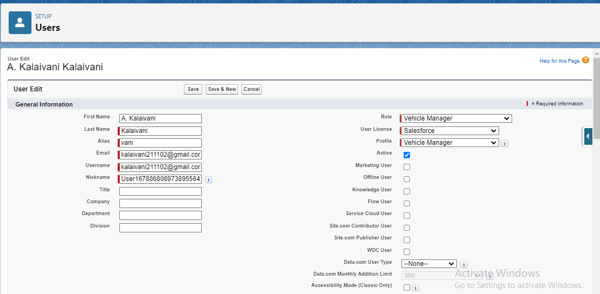
USERS
A user is any one who logs in to slaseforce. Users are employees at your company, such as sales reps , managers and IT specialists, who need access to the company ‘s records .

Slide 14
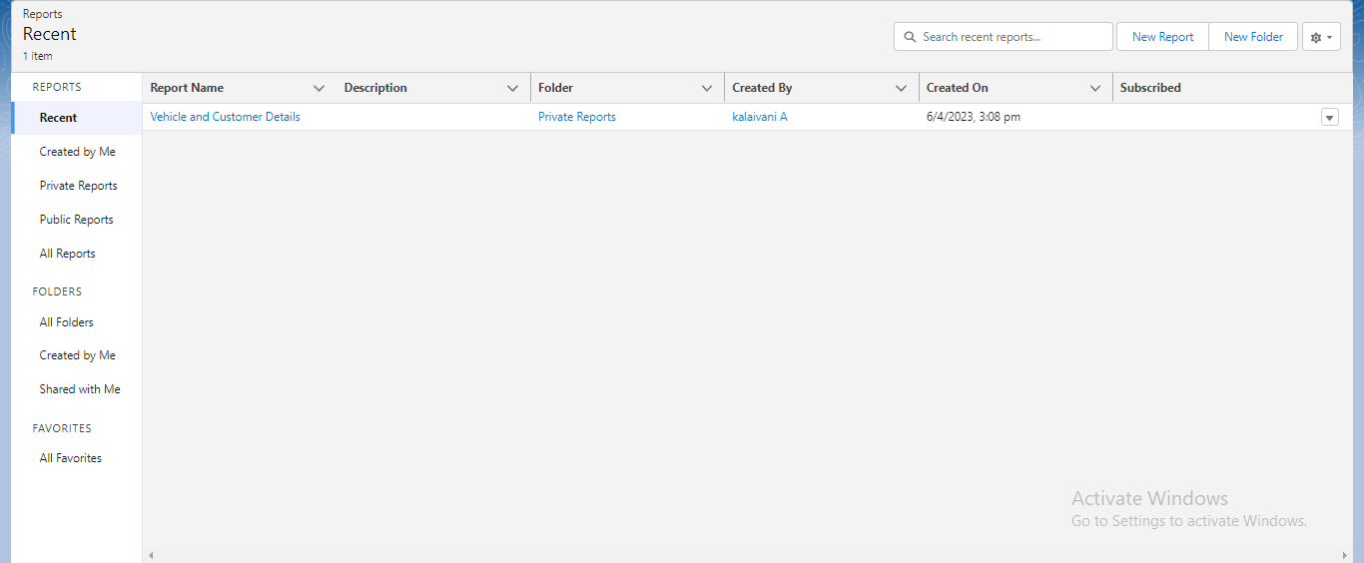
REPORTS
Report is a list of records that meet the criteria you defin.

Slide 15
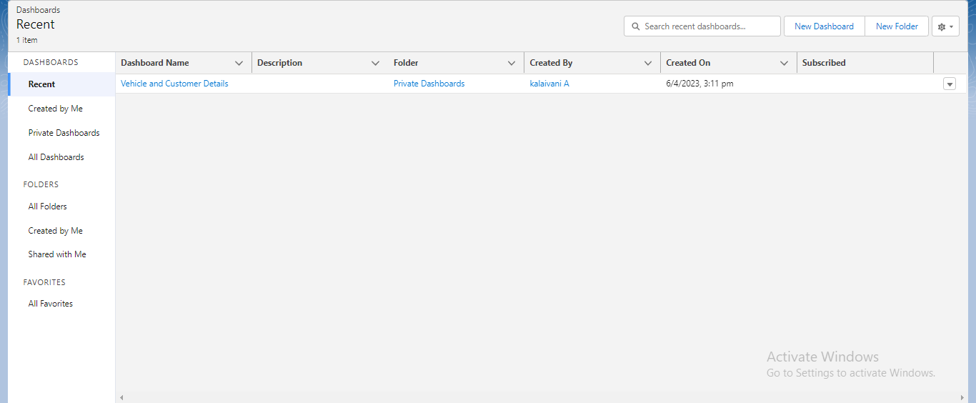
DASHBOARD
It’s displayed in saleseforce in rows and column, and can be filtered , grouped or displayed in a graphical chart.

Slide 16
TRAILHEAD PROFILE PUBLIC URL
Team leader : https://trailblazer.me/id/kvani46
Team member1 : https://trailblazer.me/id/bboomika
Team member2 : https://trailblazer.me/id/birum2
Team member3 : https://trailblazer.me/id/mnagu2003
Team member4 : https://trailblazer.me/id/kjothi5

Slide 17
Advantages
Duplication of the vehicle data is avoided
As vehicle number is already stored in the master therefore human mistakes can be avoided
Timely alerts ensure that penalties are avoided
Disadvantages
It is difficult to manage and maintain fleet management system due to use of multiple technologies such as cloud servers, cellular wireless systems, fleet management software etc.
It requires skilled resources to maintain such system. This increases maintenance costs.
GPS device used in fleet management is power hungry which drains battery faster.
.

Slide 18
Application of vehicle management system
The vehicle Management System is an application for the automotive industry is support in the area of sales & service.
The business process that your require as vehicle importer when dealing with your original equipment manufacturers and your dealers in new and used vehicle sales.

Slide 19
CONCLUTION
In this system the transport management, designed and developed a low cost system based on integration of GPS and XBee data is described.
The system consists of different modules which are linked wirelessly with XBee.
Cost effective XBee service is used for the transfer of data between the modules.
A new service, to facilitate the people who use school buses or company cabs for traveling, is introduced.
The service provides the user with current location information of desired vehicle with locking system if it changes the usual way.

Slide 20
FUTURE SCOPE
Vehicle management systems nowadays, include a host of different features.
GPS vehicle tracking is such an essential part of vehicle management system.
Any educational institute can make use of it for providing information about user, content of the available notepad feature.
To build up a system that provides and generates the summery.
A web based tool where user can search for additional information of the vehicle.

